Slide 1
Measuring g with a pendulum via Matlab
Johnson Chen

Slide 2
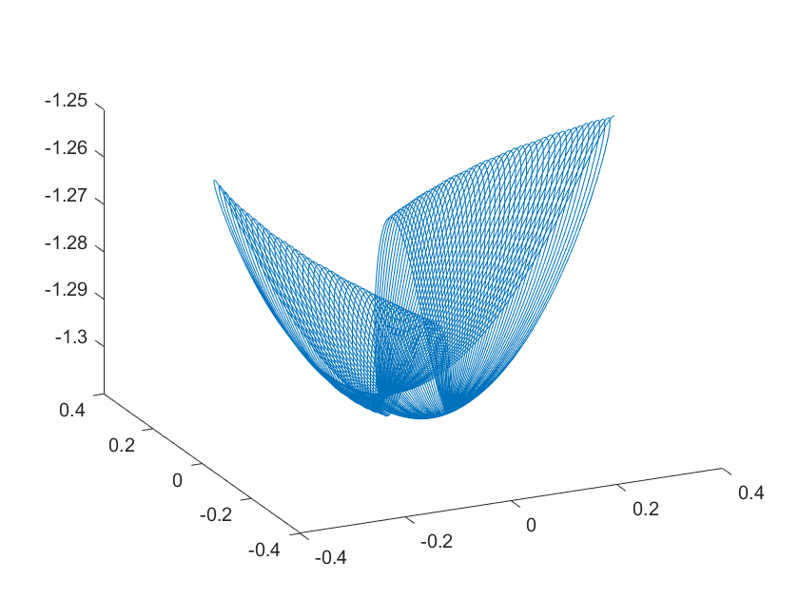
Purpose
Rpi will measure acceleration in x y z direction of Rpi frame, and distance from Rpi to ground
Rpi in pendulum bob while pendulum is swing will produce this accel_z
Software has numerical solver for 3D pendulum motion that can predict this motion (given input parameters g,B,C, and initial conditions)
g is gravity (m/s^2), B is linear air drag term divided by mass, C is quadratic air drag term divided by mass
Motion of pendulum in 3D

Slide 3
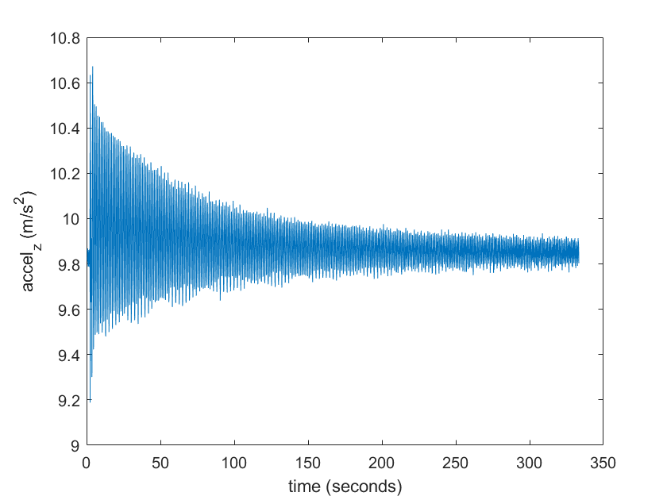
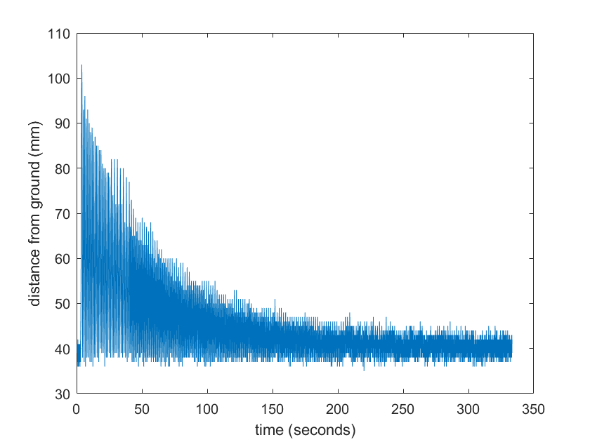
Pictures of data
Rpi data distance from ground
Rpi data a_z

Slide 4
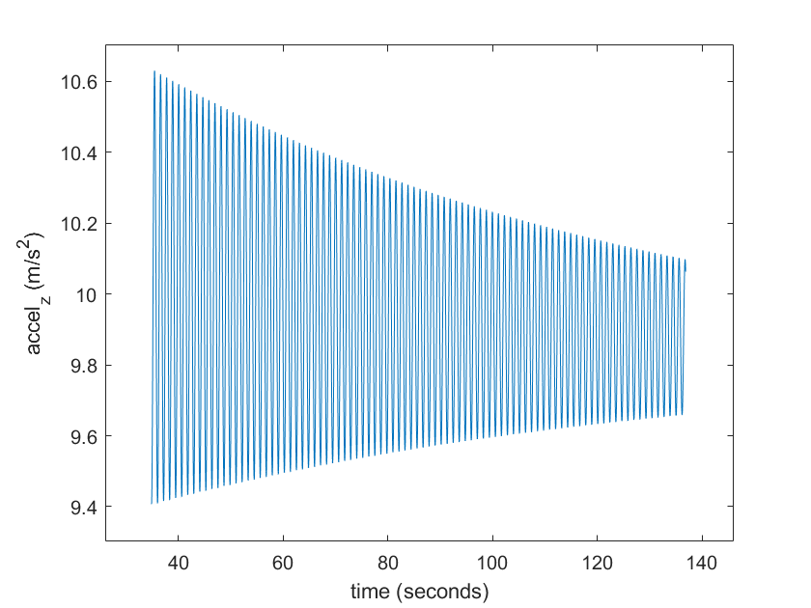
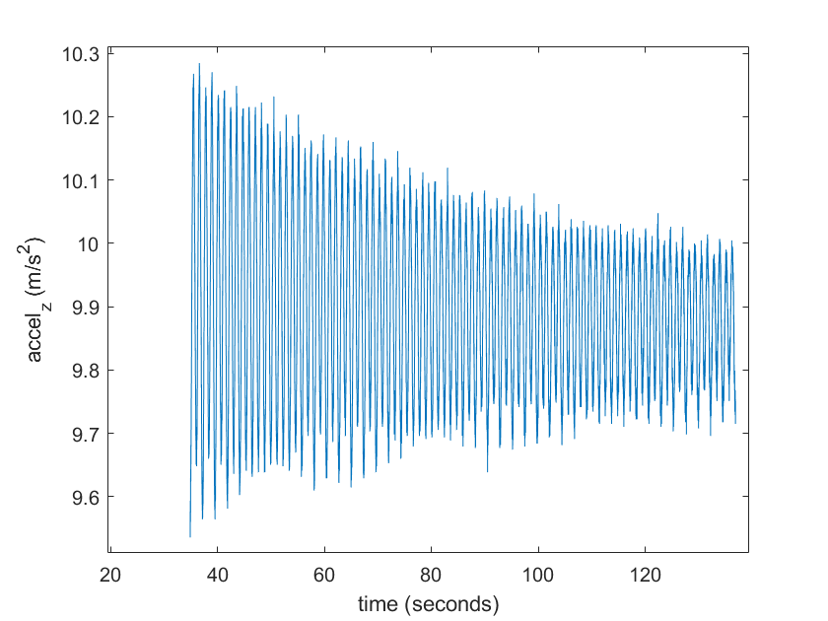
Purpose (cont)
Varying the input parameters of the numerical solver such that the square residual between the numerical output and Rpi data will allow one to find the g, B, C, and initial conditions of best fit
Predicts g, B, C
Showcases fitting methods employed in research
Top picture is numerical solution, bottom picture is data from Rpi

Slide 5
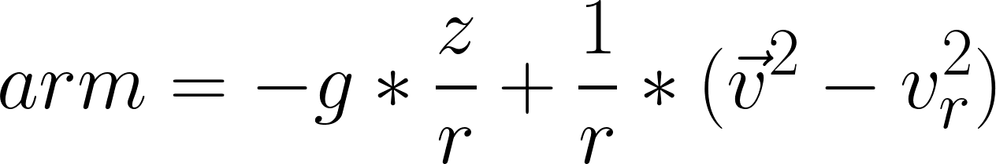
Aside on accel_z from Rpi
The Rpi measures the force it feels in the frame of the pendulum
Works via a little spring in the Rpi and checks the length of the spring
It will measure centrifugal force and gravity
Measured along the string (r direction) and is in Rpi frame
Call it arm (acceleration along r, measured in Rpi frame)
arm_new in Conical_pendulum is predicts that quantity

Slide 6
What is included?
Matlab Script | Purpose | Input | Output
conical_pendulum | Model 3D motion of ideal pendulum | G, b, C, and initial conditions | Position data
data_process | Slice raw data into usable chunk for analysis | Raw data | Sliced section of raw data suitable for fitting
lsqcurvefit | Fit sliced raw data to optimize g, b and C parameters | Slided data, initial conditions | G, b, and C values optimized for fit with minimized square residual
Program requirements: entire package on Github

Slide 7
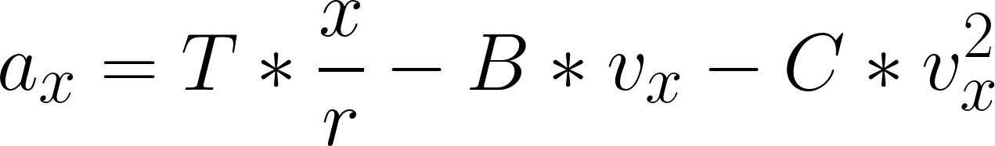
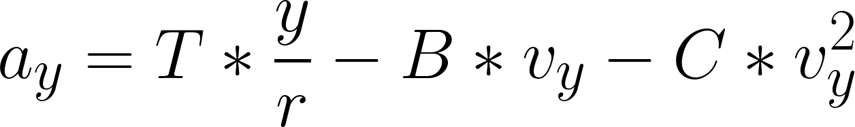

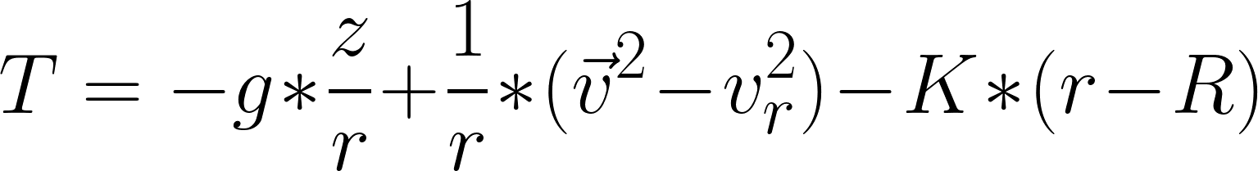
How it works: Conical_pendulum
Calculates the predicted arm value via equations of motions of 3D pendulum
Uses improved Euler method with time step of ts = 0.001 seconds
K is large to simulate taut string

Slide 8
How it works: data_process
Unprocessed data is difficult to fit, need to splice the data to a smaller size and extract proper initial conditions
Data_process function down sizes the data (beginning and end chosen by user)
Determines beginning time from user input beginning location and extracts the initial position via distance_data from Rpi

Slide 9
How it works: data_process
Splice data to ease fitting
Data_process function down sizes the data (beginning and end chosen by user)
Determines beginning time from user input beginning location and extracts the initial position via distance_data from Rpi

Slide 10
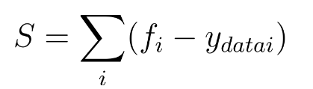

How it works: lsqcurvefit
The fitting process itself makes use of the built in Matlab lsqcurvefit command
The command uses the Trust-region newton method, which is a modified version of the Gauss-Newton algorithm
Looks for fit in parameter space via calculating the Jacobian at every step and then moving in the minimizing direction of the square residual

Slide 11
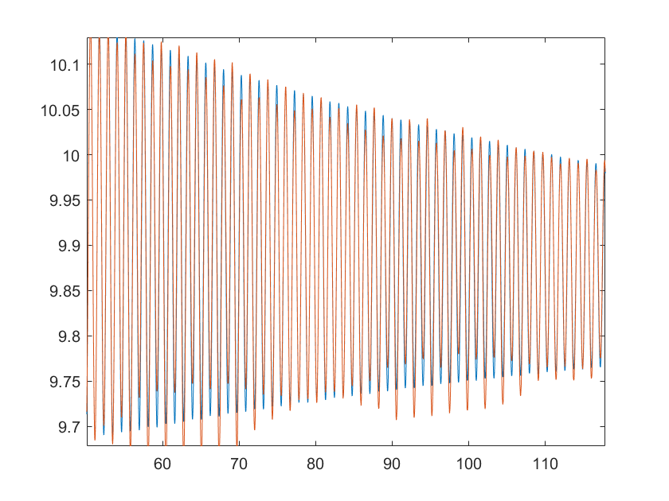
Example fit 1
Fit with rolling average g = 9.4632 B = 0.0108 C = 0

Slide 12
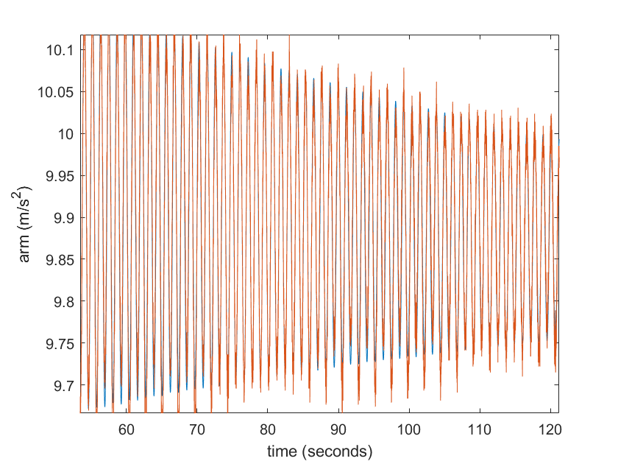
Example fit 2
No rolling average
g = 9.4664 B = 0.0106
C = 0.0058

